Slide 1
A3- Progress Presentation
An Investigation into the Effects of Environmental Deformation Over Time Using Node-Based River and Sediment Simulation
A Portfolio Project

Slide 2
Context and Justification
“My aim is to create a tool that generates a landscape and manipulates it over a user-defined period of time to form rivers and lakes through simulation of fluid dynamics, including the pick-up and deposit of sediment.”
Or in fewer words…
I want to create a tool to generate a realistic 3D landscape, which is eroded over time by water.

Slide 3
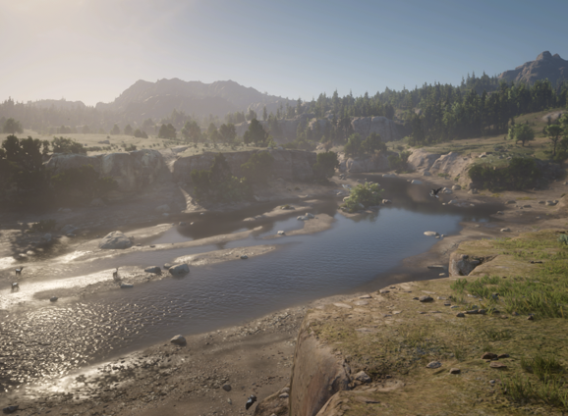
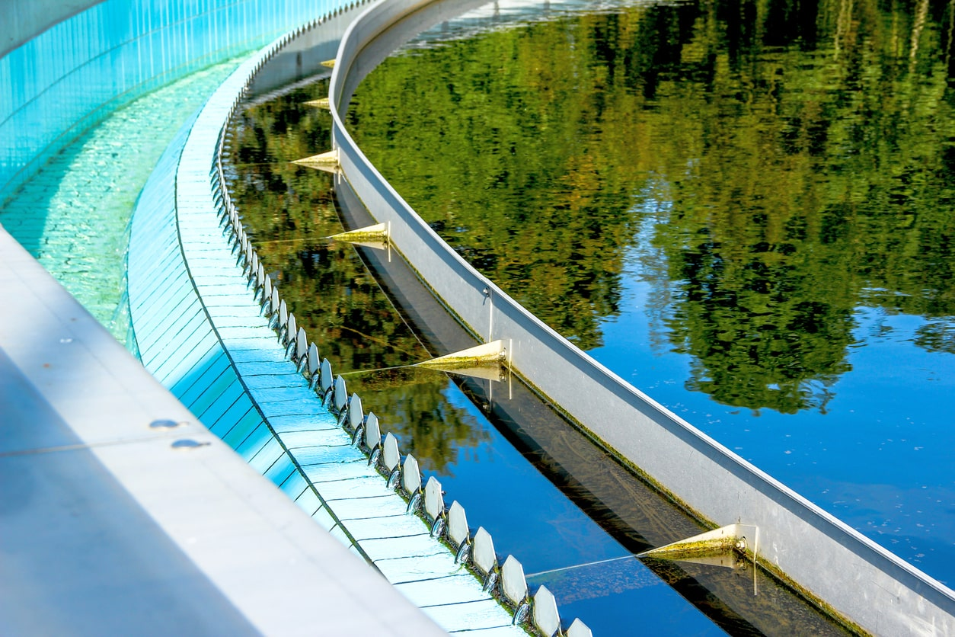
Context and Justification
Why?
Many uses for large-scale fluid simulation
Flood prevention
Architecture (construction of dams, turbines and manipulation of the path of water)
Landscapes based in realism for games
It’s a field that interests me
Mathematical background
Keen interest in 3D world creation/manipulation
Lack the art skills to design 3D environments
Red Dead Redemption 2- Rockstar Games
Simulation in Construction- SimuTech

Slide 4

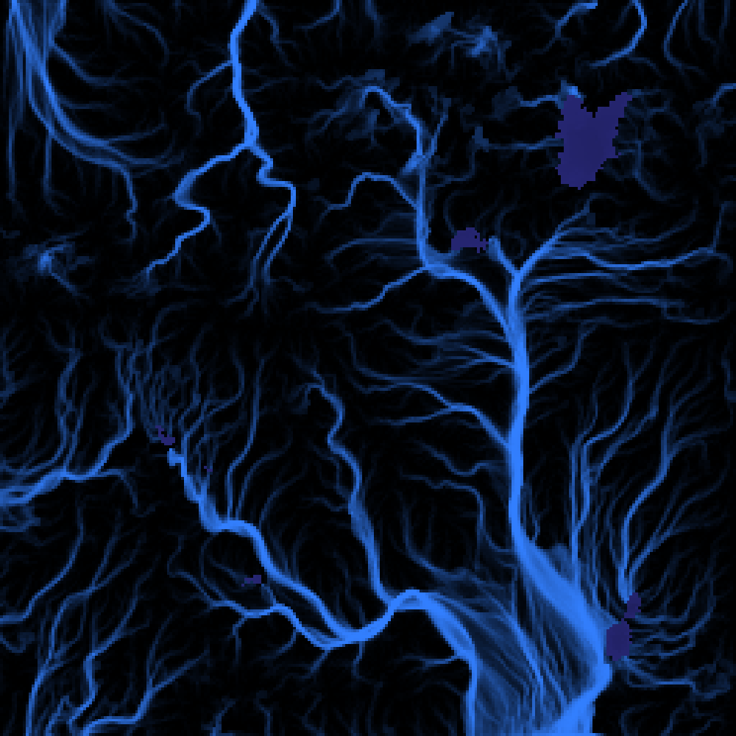
Research and Similar Studies
Is this going to be ground-breaking work?
Short answer- no.
But it’s a bit more complicated in practice.
Fluid dynamics & simulation is a huge field.
Varying scales of both landscape and time.
Many studies assume the fluid is held in a regular cube and focus on current and movement.
Fluid dynamics is also widely used in aerodynamics calculations and weather simulation/prediction.
Finite Volume Fluid Simulation- P. Mocz
Procedural Hydrology- N. Mcdonald

Slide 5
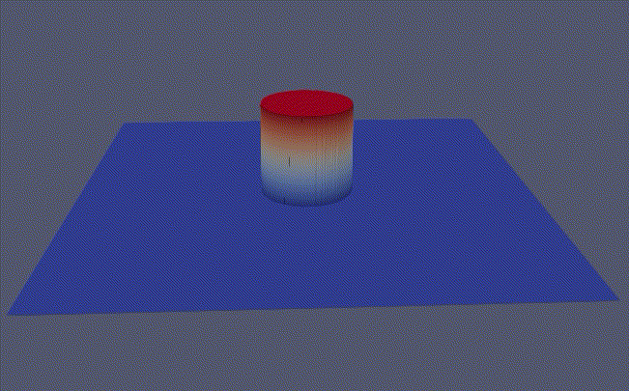
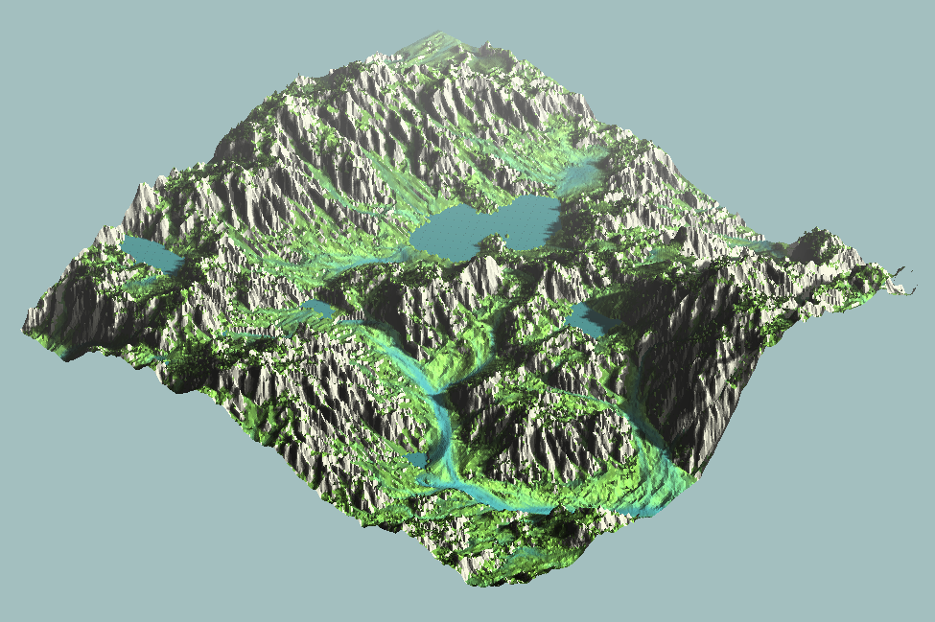
Research and Similar Studies
Closer to what I’m trying to produce-
Studies into landscape erosion and hydrology by N. Mcdonald.
Shallow water equation solving by F. Kohler.
Navier-Stokes finite volume equations.
Lattice-Boltzman algorithm.
All of these tackle similar concepts. Mcdonald’s study even features node-based erosion!
..
Solving Shallow Water Equations- F. Kohler
Procedural Hydrology- N. Mcdonald

Slide 6
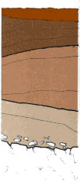
Research and Similar Studies
These studies all lack a significant thing- a soil map
Different kinds of sediment
Varying landscape strengths- rock erodes slower than soil
Allows “architecture” of a simulated landscape by a designer
Increased complexity, yet significant improvement to realism of simulation
Requires modification of all equations to support a variation in landscape erosion
Making a Soil Survey- FAO.org

Slide 7
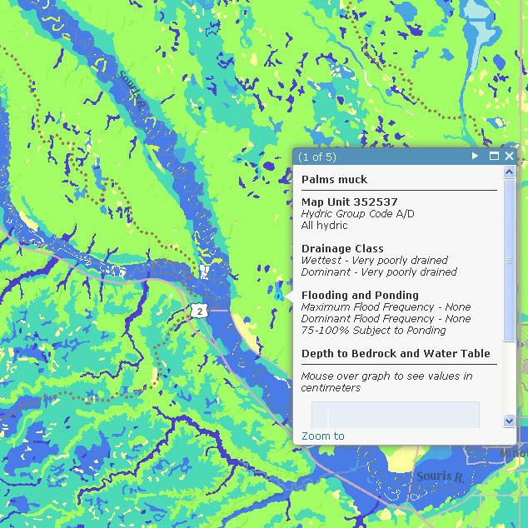
Research and Similar Studies
The SHUSWMA is
Soil Hydrology of the United States Web Map Application
(and a terrible acronym)
A vertical slice of soil properties and flood chances
Flood chances obtained solely through real data from the SSURGO dataset- we only know after it floods!
SSURGO stands for Soil SURvey GeOgraphic database
(which is an even worse acronym)
This does store depth to bedrock and water, which is useful information!
No horizontal slice.
Soil Hydrology of the United States Web Map Application
- ArcGIS.org

Slide 8

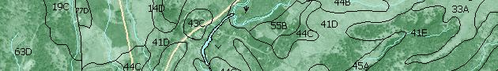
Research and Similar Studies
Info from the SUSHWMA can be used for approximating data for my application.
It also provides a good point of comparison- my rivers should look like real ones!
Publicly available from the USDA.
(a good acronym!)
There are three levels of digital soils data:
SSURGO - is the most detailed county level data
STATSGO - is less detailed state-wide map
NATSGO - is a very general soil map of the entire U.S
United States Department of Agriculture
This is the most useful!

Slide 9
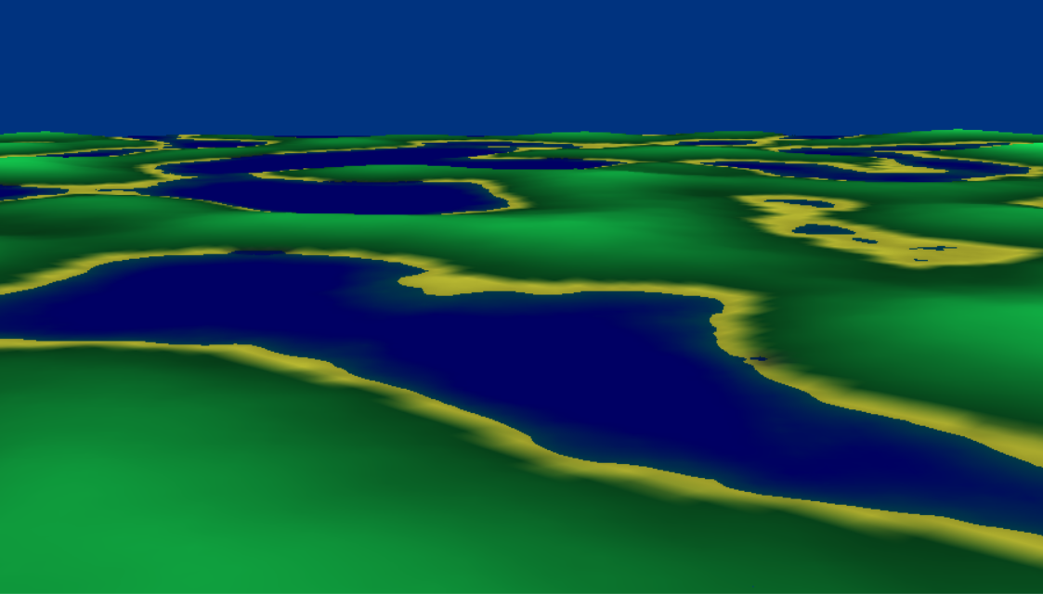
Current Progress
Where am I?
Key stages of development-
Landscape generation
Landscape rendering
Soil map creation
Implementation of hydraulic erosion model (I am currently here!)
Comparison with real-life geographical data
Optimization and improvement

Slide 10
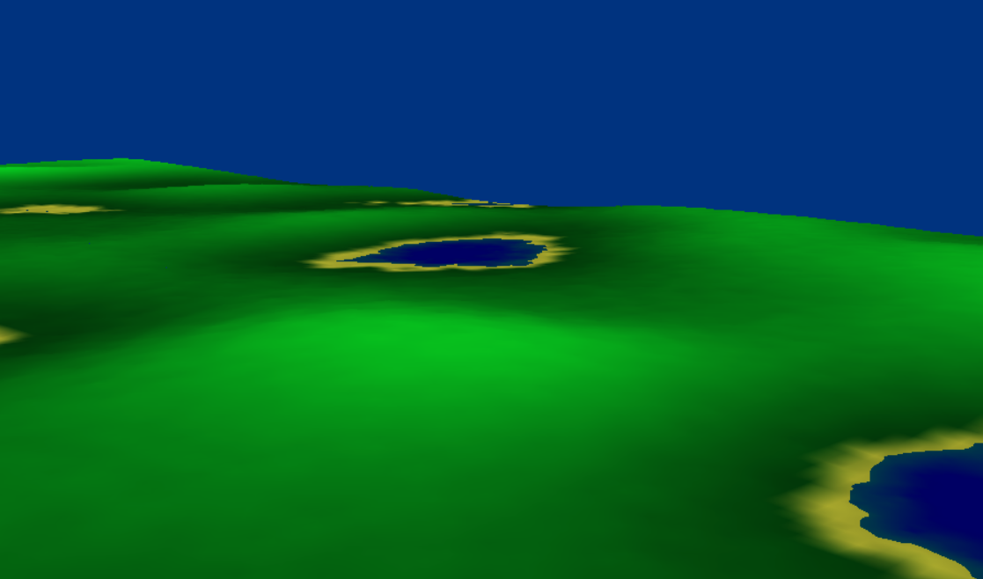
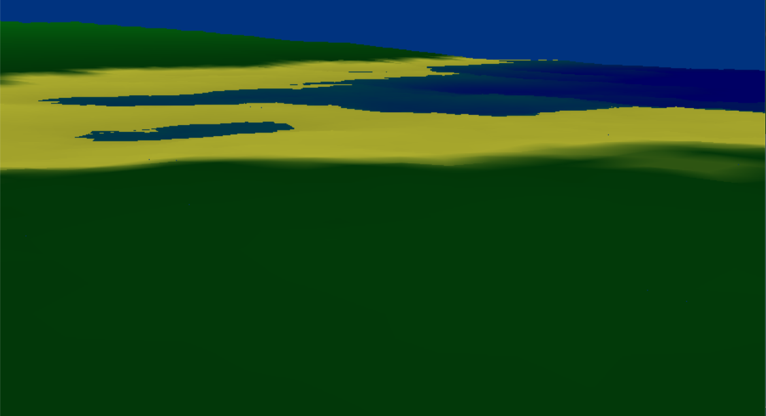
Current Progress
What have I accomplished so far?
Generation of landscape based on user-defined properties (using Perlin noise)
Dynamic mesh scaling for large landscapes
(currently supports 1km² landscape with scaling)

Slide 11
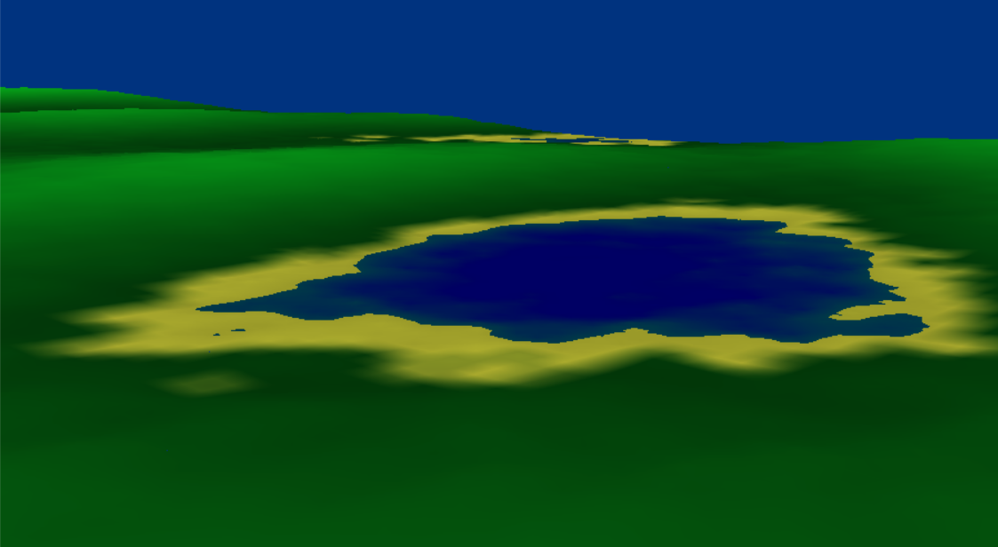
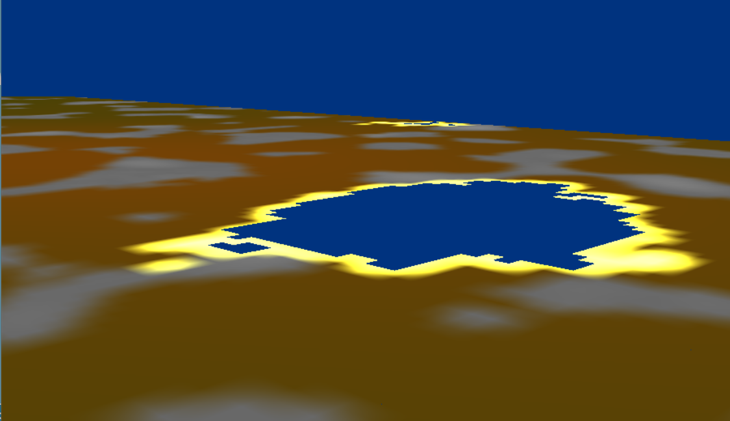
Current Progress
What have I accomplished so far?
Debug views for testing within the landscape
Can view soil map and test node data
Rocks are visible in horizontal segment- different properties and hardness values.

Slide 12
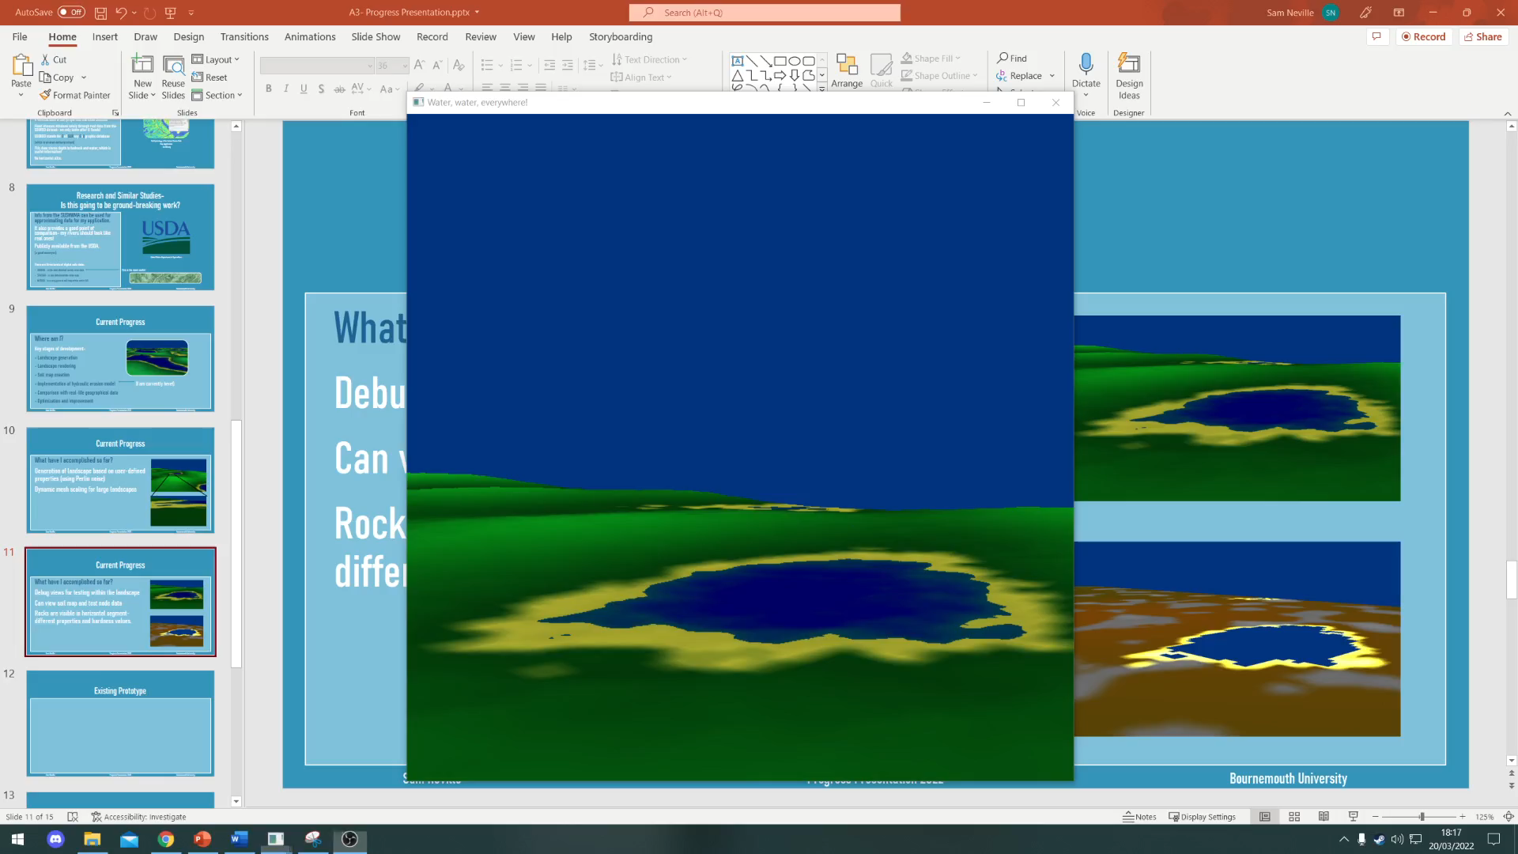
Current Progress
What have I accomplished so far?
Erosion tests for when fluid algorithms are implemented
(note that sand erodes far faster than dirt, which erodes faster than rock)
Based on real values but likely to require modification based on results comparison.

Slide 13
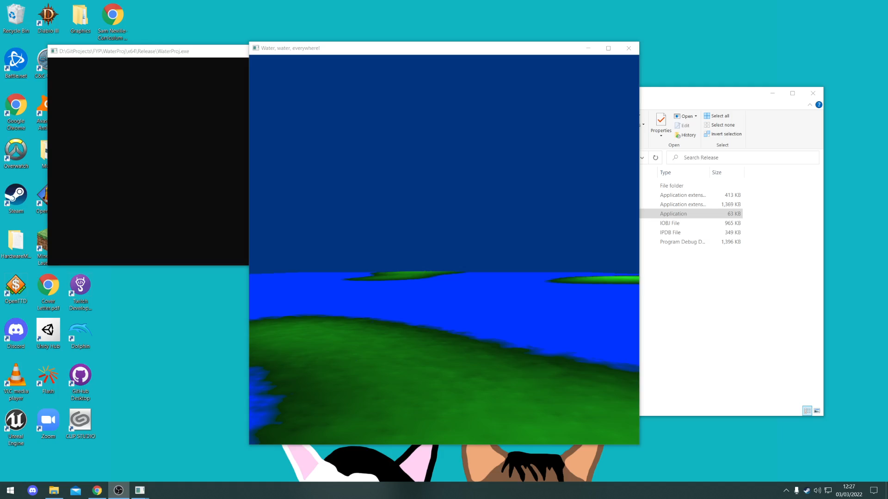
Current Progress
What have I accomplished so far?
Bulk of OpenGL work is complete
Options for both one-pass and multi-pass rendering using depth buffer (as different branches on Git)
Currently comparing efficiency and graphical fidelity
Water has less transparency and land is more pixelated in single-pass render

Slide 14
Changes to Methodology
Initial plans were to compare CPU and GPU simulation-
As this is a portfolio project and not an investigation, less focus on this.
Potential move to GPGPU simulation if time allows, as it will be more optimizable.

Slide 15
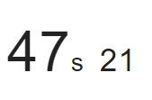
Changes to Methodology
Initially planned for particle-based system, using the Hydraulic Erosion model.
On the landscape scale I wish to simulate, my testing shows that this could be too computationally intensive.
From a test simulation (with no visual output) running on CPU
(Ideally this needs to be <10s!)

Slide 16
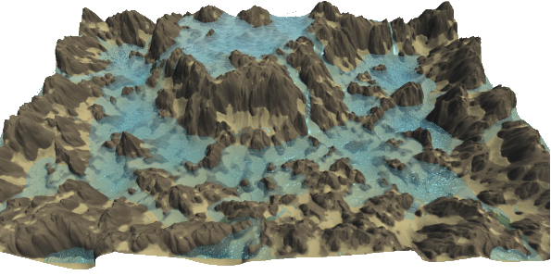
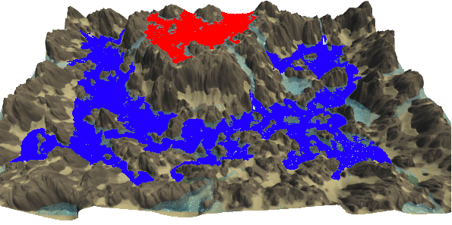
Changes to Methodology
Pooling Model
An extension of hydraulic erosion
Changes behaviour of water when in a confined space with a similar water level
Significant efficiency improvement over particle system
Introduced by O. Št’ava et al.
(particles are still used for streams!)
Interactive Terrain Modeling Using Hydraulic Erosion- O. Št’ava et al.
(with pools highlighted)

Slide 17
Completion Plan & Deliverables
First things first- finish implementing hydraulic erosion model with new pooling system. (18th April)
More realistic foliage & temperature (25th April)
This will make the program complete to my initial specification. I can then focus on evaluation & presenting my findings in the dissertation document.
Iterate on my output based on real-life SHUSWMA data (9th May)
Then, if time allows, optimize as much as possible (potential move to GPU)
Then, if time allows, additional graphical fidelity.
Graphical fidelity and optimization are NOT the focus of the project, the output is!

Slide 18
Completion Plan & Deliverables
Soil map is yet to be implemented into hydraulic erosion model, which is a focus as it makes my work distinct.
Tests for hydraulic erosion with pooling perform well, but no visual output yet.
The key deliverable is the application, with the most functionality possible in the time given.

Slide 19
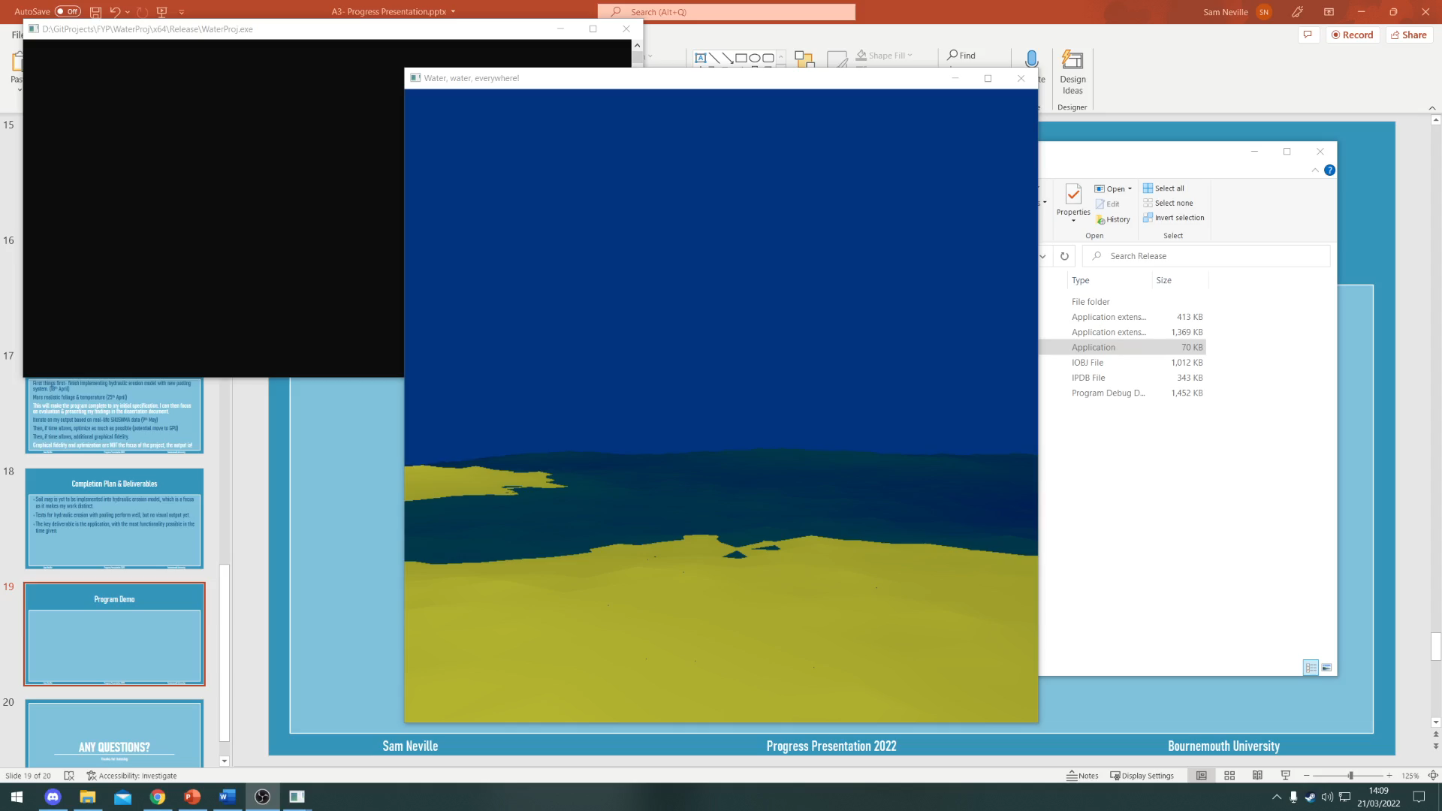
Program Demo- Video
Should also be able to run on uni PCs, for a live demo.

Slide 20
Any questions?
Thanks for listening

Slide 21
References
Peric, F., Ferziger, J.H. (2002). Computational Methods for Fluid Dynamics.
Available at: http://servidor.demec.ufpr.br/CFD/bibliografia/Ferziger%20Peric%20-%20Computational%20Methods%20for%20Fluid%20Dynamics,%203rd%20Ed%20-%202002.pdf
McDonald, N. (2020). Procedural Hydrology: Dynamic Lake and River Simulation.
Available at: https://nickmcd.me/2020/04/15/procedural-hydrology/
O. Št’ava et al. (2020). Interactive Terrain Modeling Using Hydraulic Erosion
Available at: https://cgg.mff.cuni.cz/~jaroslav/papers/2008-sca-erosim/2008-sca-erosiom-fin.pdf
P. Mocz. (2020). Finite Volume Fluid Simulation (With Python)
Available at: https://levelup.gitconnected.com/create-your-own-finite-volume-fluid-simulation-with-python-8f9eab0b8305
USDA. (2018). Soil Hydrology of the United States Web Map Application
Available at: http://www.arcgis.com/apps/OnePane/basicviewer/index.html?appid=9fb94e1d3ec84d60a60aa2846b11be67
SimuTech Group. (2022). SimuTech.
Available at: https://simutechgroup.com/

